Slide 1

Leisure activities
Mathieu dreyer
Quentin millardet
Notes:
Thank-you all for coming today
My name’s is Quentin millardet and i’m with Mathieu dreyer , we’re here to talk about leisure activities
The order of the presentation is as follows :

Slide 2
Table of contents
Your leisure activities
Example of one of our leisure activity
Notes:
First of all I will be looking at your leisure activities
Then I will move onto a Example of one of our leisure activity

Slide 3
1.
Your Hobbies
Let’s start with your experience
Notes:
Did anyone do an activity this weekend ?

Slide 4
2.
Our hobbies
Notes:
This week, we have do an activity that links hiking, relaxing, outing.
This activity is a game, in which we can collect pokémon.

Slide 5
Pokemon Go
More than a game
Outdoor games
Augmented reality game
Cooperation game
Notes:
this game is on handy, and it’s call : Pokemon go
Indeed, this game is an outdoor game, which allows you to capture different pokémon.

Slide 6
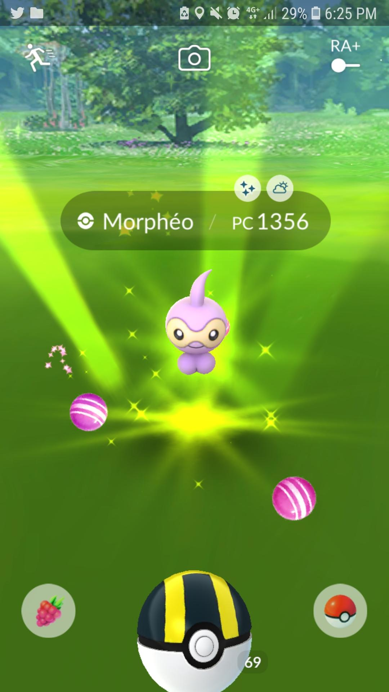
Game on
handy
Catch’ Em all
Place your screenshot here
Notes:
To capture pokémon, we have to go out and walk down the street to find them

Slide 7
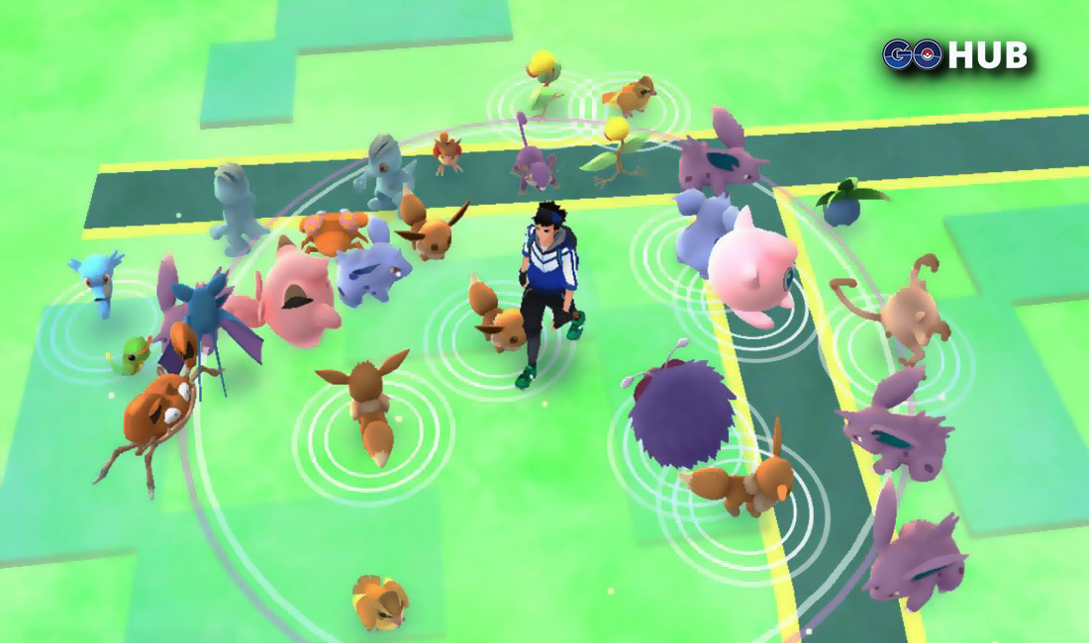
Catch’ Em all
Place your screenshot here
Notes:
we can see an example here.
the pokémons will appear near us
but this game is not just about that.

Slide 8
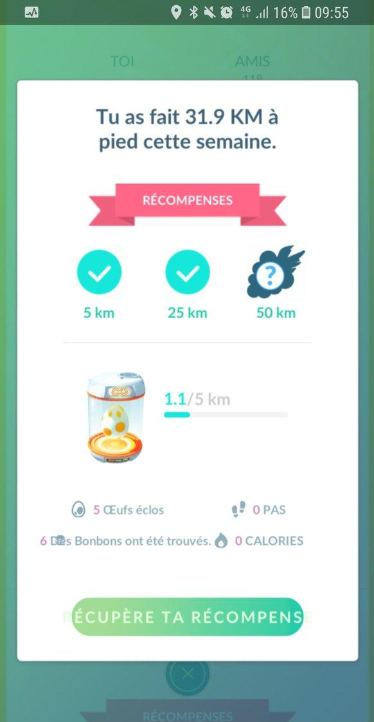
Walk and
Get
reward
in this game you need to walk to hatch eggs or for your pokémons
Place your screenshot here
Notes:
every week depending on the number of kilometres we have walked, we receive a reward.
then, the more we walk, the more candy we earn to make our pokémons evolve. we also earn eggs, in which there is a pokémon, and we have to walk a certain number of kilometres to make it hatch.

Slide 9
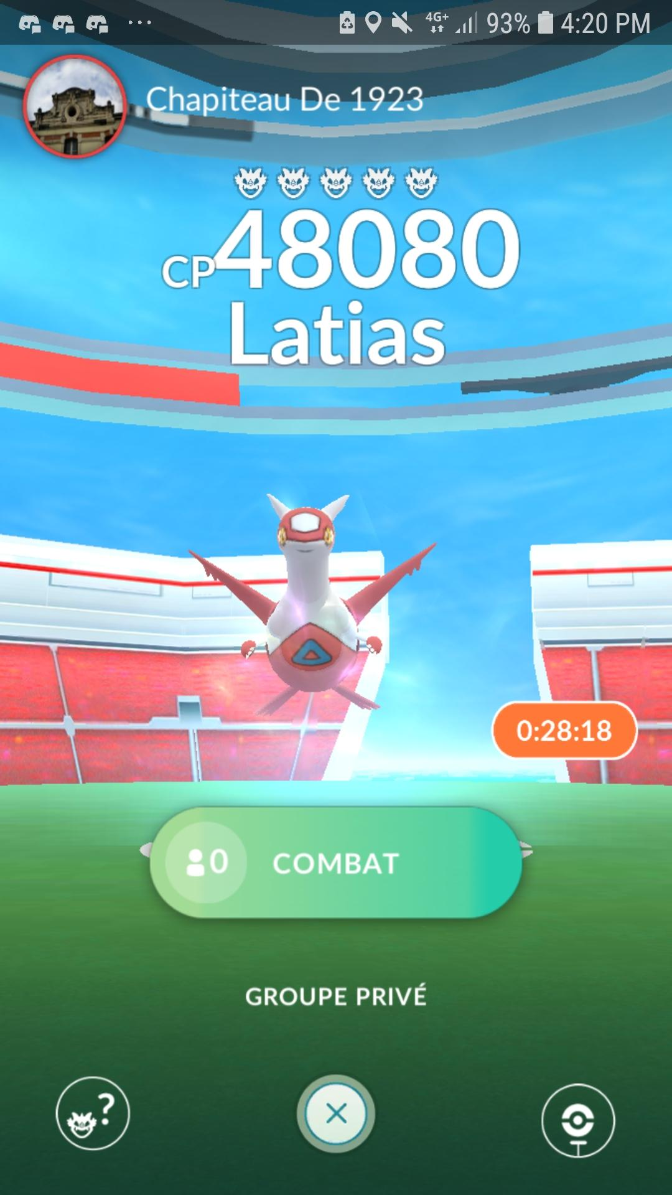
Fights pokemon
Some boss appear and to beat them you have to be several
Place your screenshot here
Notes:
well, in this game, there's a boss principle, which you have to kill.
However, this boss is not possible to kill when you are alone, so you need to be several.

Slide 10
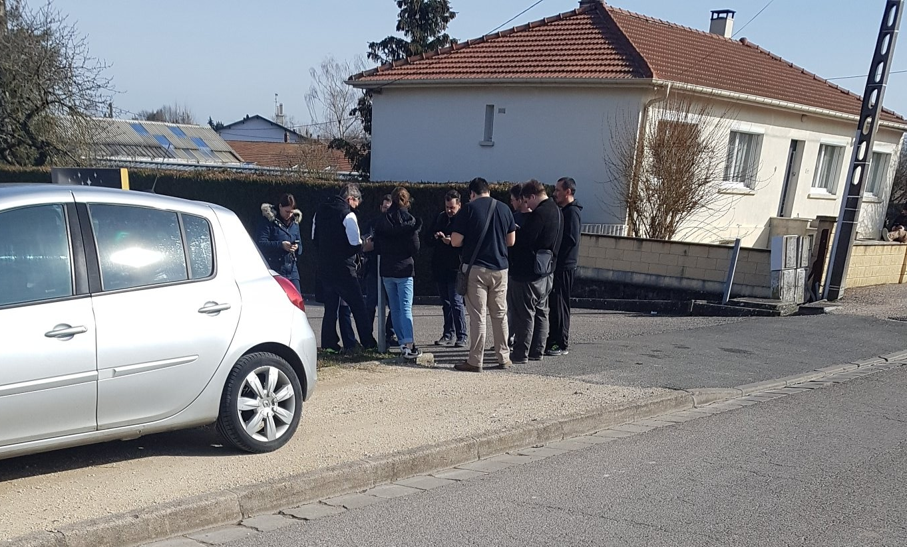
Some boss appear and to beat them you have to be several
Place your screenshot here
Notes:
like here, for example, a boss I did on Saturday with players from Toul.

Slide 11
Thank you for your attention
Any questions?
Notes:
thanks to this game, we can create friendships, and get together to play, etc
diapo finale
remercier de l’écoute bla bla bla

